Slide 1
SKATING PLAYER MANAGEMENT SYSTEM
Team members
R V S Teja Krishna 17MIS7085
K Varun Teja Chowdary 17MIS7156
P H S Abhiram 17MIS7073

Slide 2
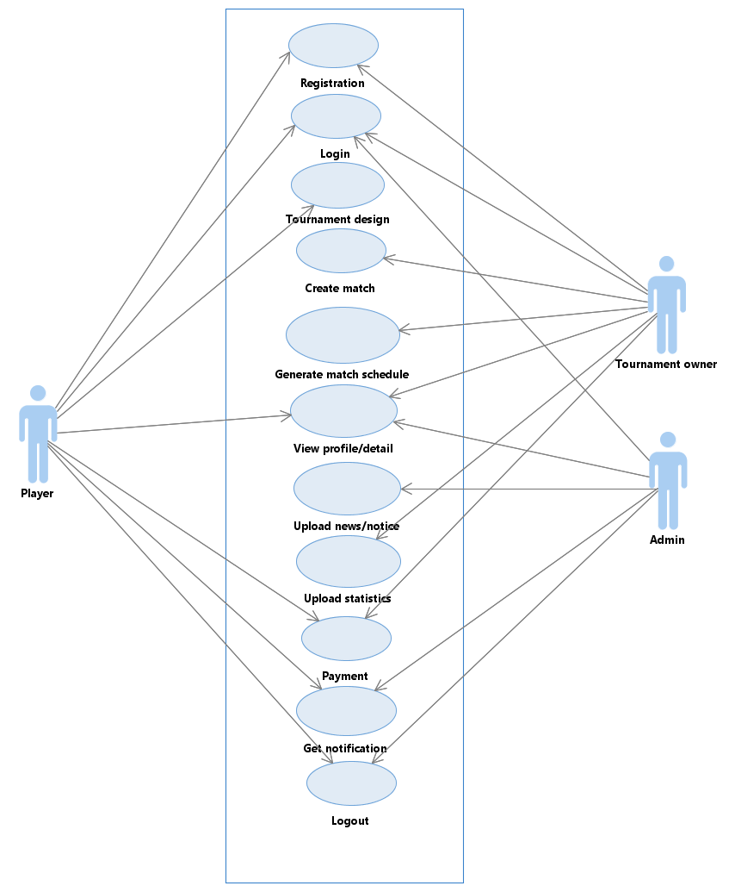
USE CASE DIAGRAM

Slide 3
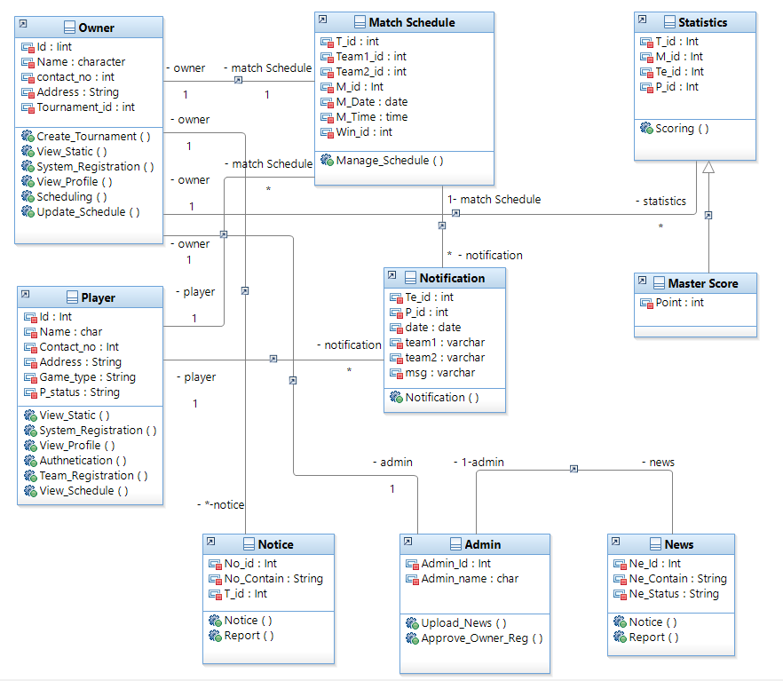
CLASS
DIAGRAM

Slide 4
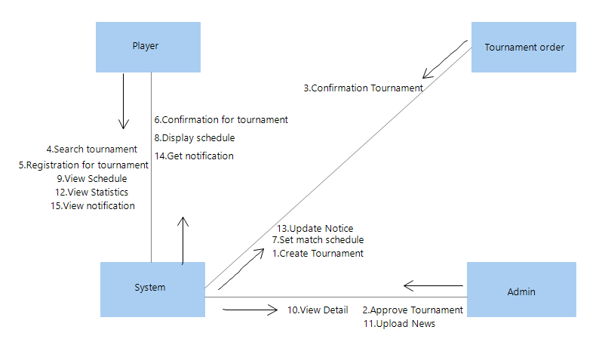
COLLABORATION
DIAGRAM

Slide 5
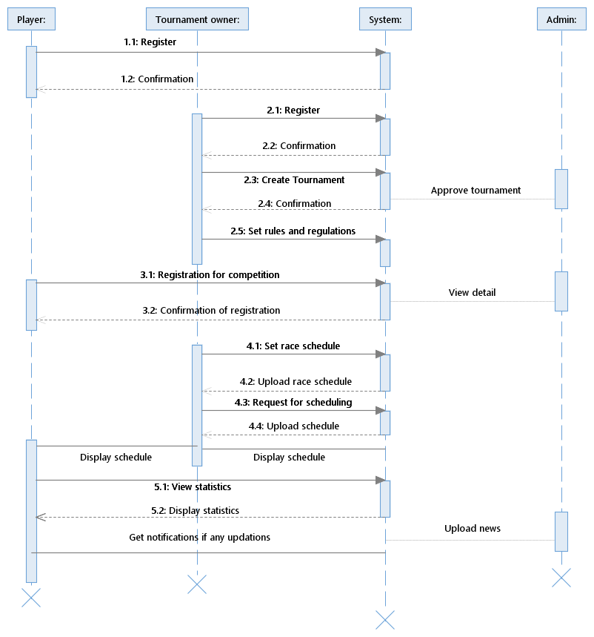
SEQUENCE DIAGRAM

Slide 6
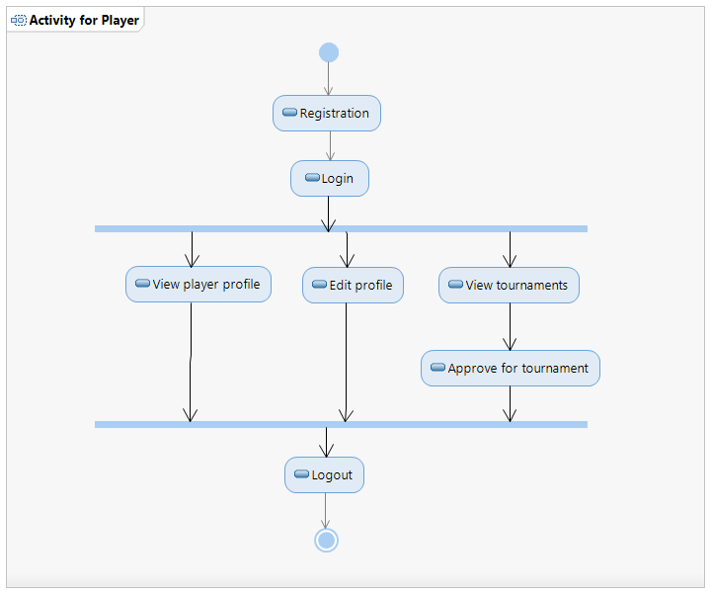
ACTIVITY DIAGRAM

Slide 7
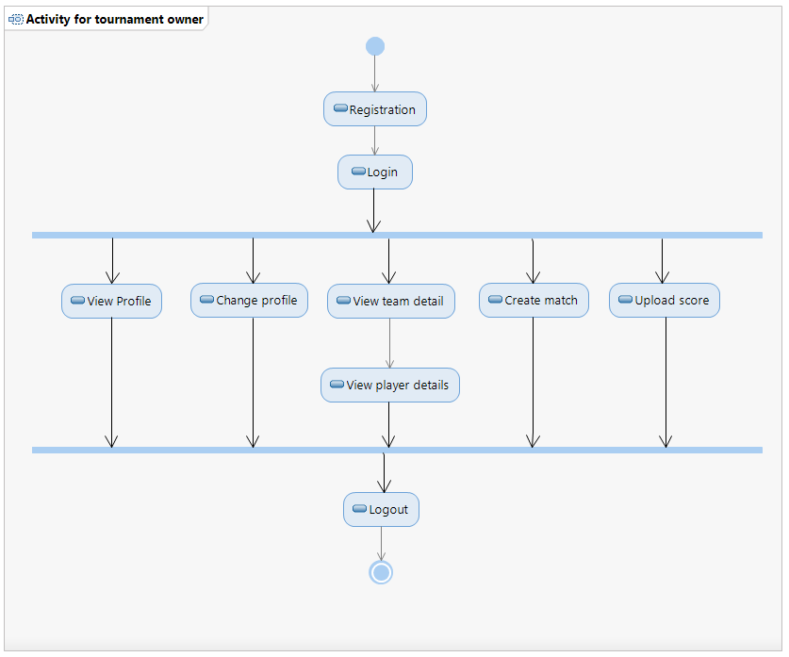
ACTIVITY DIAGRAM

Slide 8
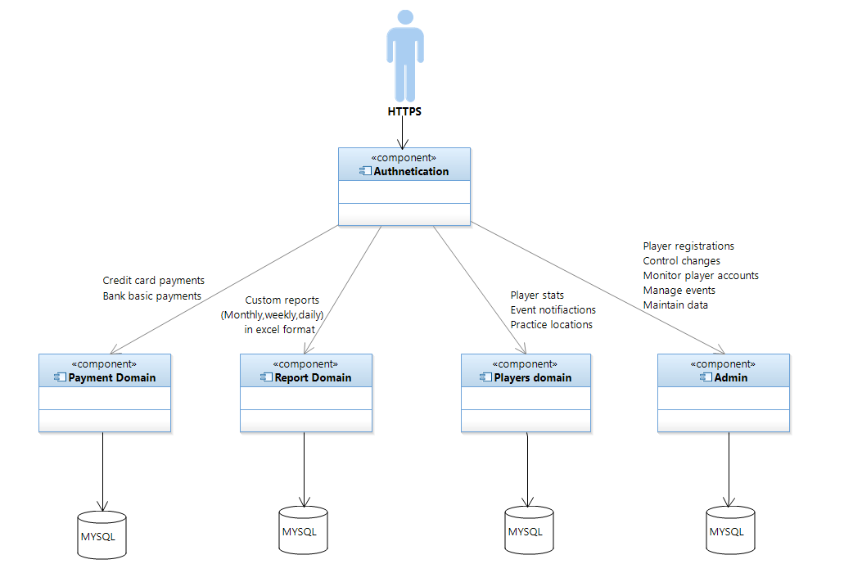
ARCHITECTURE
DIAGRAM

Slide 9
THANK YOU ☺

